Slide 1


Pandemic Leadership
University Response to the COVID-19 Pandemic
Matthew Fuller, Ph.D., SHSU Center for Assessment, Research and Educational Safety (CARES).

Slide 2
Think about the moment in which we find ourselves…
Notes:
You’re a leader…you have a specific function at your institution. Then comes this event…a pandemic. You’ve likely had new duties…or people are looking to you for guidance, stability, and reassurance. You may have your own personal health challenges. You may have families that look to you for love and care.
The moment I find myself is to hopefully offer you some hope, some laughter, a moment of levity, some guidance, some leadership tips, and the chance to keep people safe. While we will laugh, I am not making light of this very serious situation. Neither should you as a leader. Think they are in a confidential space and laugh at the absurdity of being in an organization right now…not really laughing interpreted wrong.

Slide 3
In short, March through July have been a rough year.
“I’m usually not this exhausted until March or April of the school year.”
Notes:
Yesterday I ran into my son’s school counselor at the grocery store…Think about it…just going to the grocery store and seeing people is a nice commodity…And she told me that she is just tired, exhausted.. That “she just

Slide 4
What I believe we’re called to
do as leaders in a pandemic…
Notes:
Matt

Slide 5
People are looking to you for hope, guidance, and to preserve the future…
In a time of great uncertainty and fear…
When information is incomplete and biased…
And the decisions you make have immediate, lasting, high stakes implications…
And will automatically upset half of everyone involved…
(and most of those who aren’t involved).
Notes:
Matt

Slide 6
We’ve been through this before.
Theories can help you.
But, there’s good news…
You’re not alone.
Notes:
Matt

Slide 7
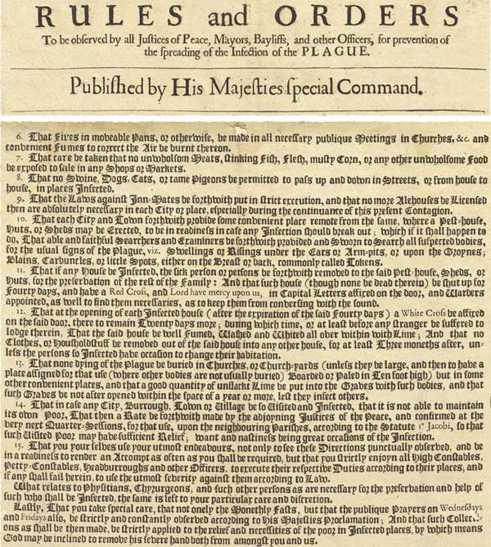

This actually isn’t our first rodeo…or our second…third… Or 100th.
Notes:
he history of closing colleges because of epidemics dates back nearly as long as higher education itself. Britain's last major outbreak of plague came in 1665-1666. In a single week, over 7,000 Londoners died. In response, King Charles II imposed new rules to stop the spread of plague. Public gatherings were banned — even funerals. Strangers could not enter any town unless they presented a certificate of health. Towns were ordered to create "pest-houses" in remote locations to house the infected. Nearly 2 years on his farm in Lincolnshire…He left Cambridge. Two years were productive.
Outside of higher ed context, you have of course the dozen or so plagues that struck the Roman impire, Every continent and every race faced spread and has stories of this.

Slide 8
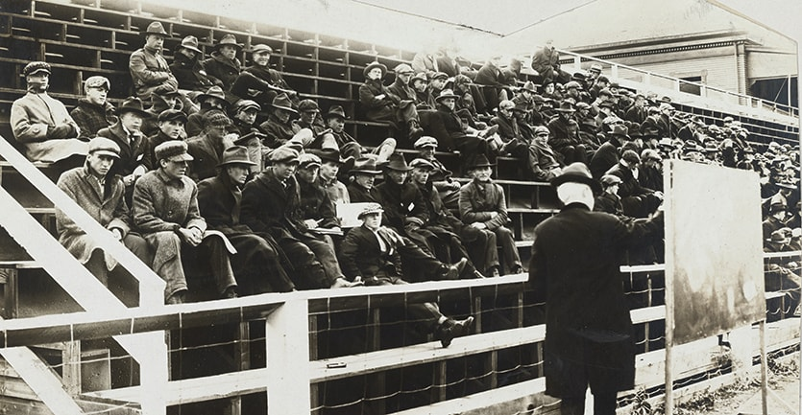
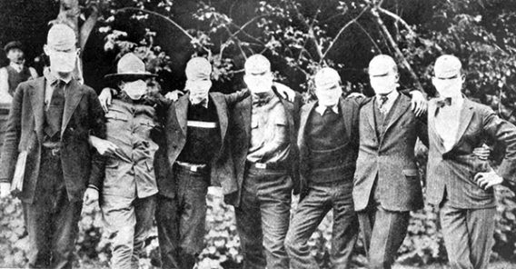
Spanish Flu of 1918
Notes:
Spanish flu killed 50 million people world wide and lasted a year.. These young men are Stanford students who had a mask order in place. We see eerier similarities in limiting gathering, dips in enrollment, deaths, ice boxes for corpses, and mental health. And classes were held outdoors.
At the University of North Carolina, the father of an undergraduate student wrote to the university's president, Edward Kidder Graham. The letter read, "Should our son John come down with influenza and his condition in any sense be serious, please notify … by wire at my expense.”
In 1918, an influenza epidemic began in the American heartland before spreading around the world, eventually killing 50 million people.
In October 1918, the entire UNC campus went under quarantine, and Graham himself died from the flu. His successor, Marvin Stacy, also died during the outbreak.
At Elon College, the influenza epidemic struck in mere days, spreading to 75% of the students. With no time to close campus, the college transformed its gym into a makeshift infirmary, with healthy students nursing those who fell ill.
In fact, there is an adaptive moment for higher ed in the Spanish flu…the development of makeshift infirmaries in gyms, quads, etc. led to the development of campus health centers and was still fresh on the leaders’ minds when vacines came to play in the late 20th century.

Slide 9
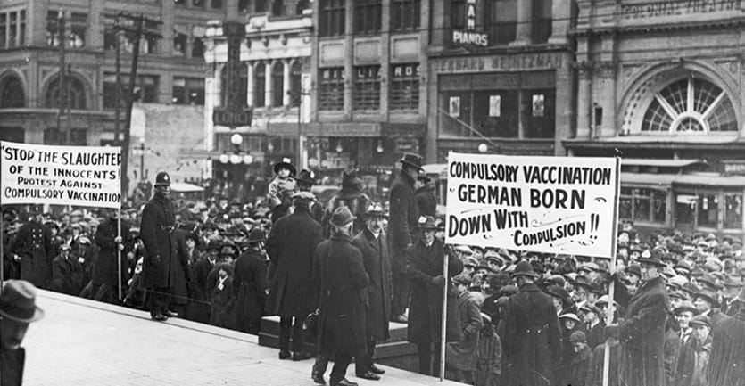
Vancouver’s 1928 Smallpox outbreak
Notes:
You can see we often react irrationally, hastily, and with racial dissent…and with resistence to government involvement.

Slide 10
More recent history
2019 UCLA measles outbreak
West Nile
MERS
STDs
2003 SARS
EBOLA
Flu
MRSA/FEB
Meningitis
H1N1
Notes:
See there are protocols in place for things like menegitis, the flu, or MRSA. Now before anyone says, yeah but COVID is not like those. You’re right. But if you allow that to anesthetize you to the lessons you can learn from those outbreaks for this one, you’ve missed the point of this discussion. There are protocols we can draw on to make decisions and many of you already have experience with these issues. Don’t buy into the notion of false dichotomies; that this is a problem completely unlike anything you’ve faced before. Doing so will cut your courage and ability to respond. IN fact, the Homeland security council directly lists college leadership as critical to the response toa national influenza pandemic in its 2006 pandemic response plan.
After the 2003 SARS epidemic, one Singapore university began issuing personal thermometers to faculty and staff. The university also instituted a policy to quickly transition courses into an online format if an epidemic forced school closures. In 2020, when COVID-19 hit Singapore, the university was able to transition over a thousand courses to an online learning environment in less than 12 hours.

Slide 11
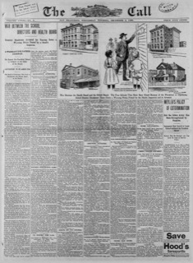
And in K-12 settings
Notes:
You can see we often react irrationally, hastily, and with racial dissent…and with resistence to government involvement.
Becky Howard at Lone Star College….The local health authority and schools were in a tussel over who had the authority to shut the school in Kansis in the 1890 Diptheira

Slide 12
In Texas…
Yellow fever: 1853, 1854, 1858, 1859, 1862, and 1864.
Scarlet Fever (typically children 5-12), 1858
Dengue Fever- Bryan, 1885 (nine years after TAMU opened)
Pneumonia, Smallpox, Measles, Meningitis, Cholera, Malaria, Diphtheria, Tuberculosis, Rabies, Whopping Cough
Influenza
Page (2010) documented 61 different quarantine orders in Texas been 1836 and 1922.
Notes:
A few short years later, in 1844, yellow fever struck Texas with a vengeance and took one-third of the population at Galveston. From 1836 to 1867 there were almost yearly epidemics in Texas, including 1853, 1854, 1858, 1859, 1862, and 1867. ... The yellow fever epidemic of 1867 struck across the Lone Star State
Chappell Hill Female College and Soule University. Rutersville
A word on influenza and the politics of it now.

Slide 13
Why does the history help us?
Notes:
We’ve done this before. There is a global nature to this, but we’ve survived this before as humans, as a profession. In fact, I’d argue that its not the virus now that’s really hurting us as much as it is the lack of humanity we show each other. We’re quick place a value on a life. People tell, ahh, well only 49 people have died in Montgomery County. That’s great, but as a leader it sure does seem callous to dismiss 49 funerals not being able to be held, or 49 people not around for the next birthday, or the days and nights of hospitals stays for those recovering. See I started this pandmiec not believing it was a major deal, but the past month, especially, I’ve grown to respect just how easily transmitted a virus is, how much you touch things in the course of normal business, and just how much I touch my face on a zoom meeting. It draw a bit of solace that we will work through this, but we have to take precautions. There’s hope in that statement.
Your goal is to get as many people as you can across the finish line…whatever that means for you. Keeping them alive. Keeping them employed…keeping them enrolled…or just keeping people happy and cohesive as a team. Whatevery your goal is, trust me there has been sometome who has done it before and will do it again after you. The main different being online learning is an option now.

Slide 14
Also, theories can help you
Bolman and Deal’s Four Frames
Notes:
We’ve done this before. There is a global nature to this, but we’ve survived this before as humans, as a profession. In fact, I’d argue that its not the virus now that’s really hurting us as much as it is the lack of humanity we show each other. We’re quick place a value on a life. People tell, ahh, well only 49 people have died in Montgomery County. That’s great, but as a leader it sure does seem callous to dismiss 49 funerals not being able to be held, or 49 people not around for the next birthday, or the days and nights of hospitals stays for those recovering. See I started this pandmiec not believing it was a major deal, but the past month, especially, I’ve grown to respect just how easily transmitted a virus is, how much you touch things in the course of normal business, and just how much I touch my face on a zoom meeting. It draw a bit of solace that we will work through this, but we have to take precautions. There’s hope in that statement.

Slide 15
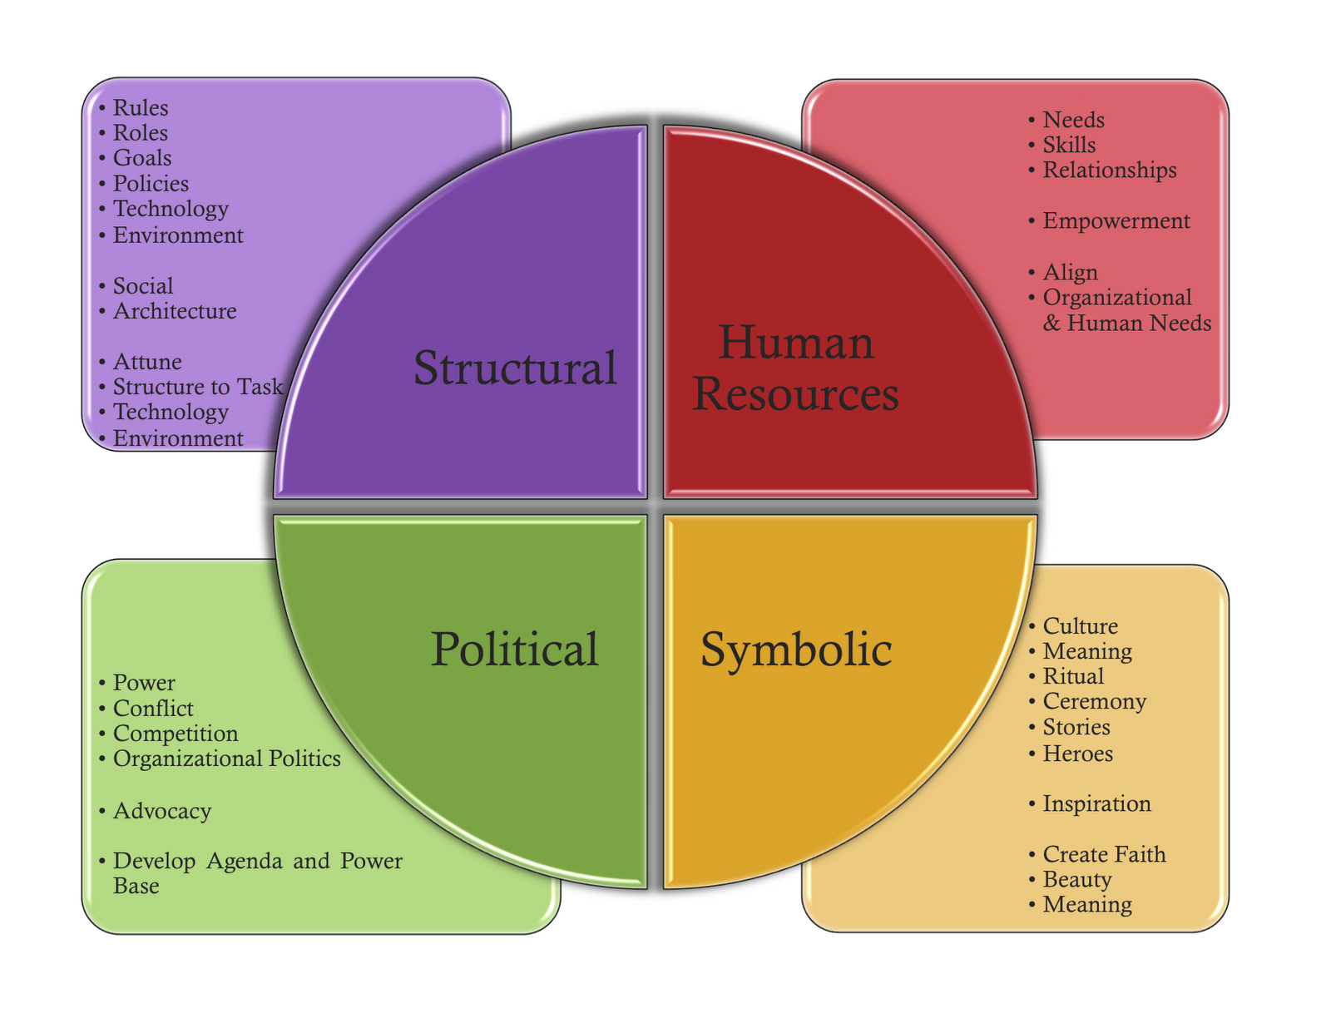
Notes:
Wicked issues…the problem that looks like something from one perspective and like something else from another…its chiral. The pandemic is a wicked issue. But the university’s response is as well.

Slide 16
A case study
Notes:
Recently, a colleague at a university outside of Texas told me this story. Their institution was a small, private, liberal arts school in the Midwest with 1,000 students enrolling. Ernollment had been flagging for years. The town this college is located in has lost every major business since 2008. Students just can’t afford to pay high college prices so those that are left are a mostly faculty members’ children or legacy families. To ward off poor fall enrollment the President directed the VP for Enrollment Management to set up an aggressive online, virtual recruitment strategy and highlight the fact that the institution has agreed to open the fall semester with remote learning. The president believes this will give potential students important information about the fall to make their decision. As a part of the recruitment effort, the President is asked to record a message inviting students to attend. The overall message is that “fuller University is open for business.” The VP implements this message and begins active recuirment with her staff. Tracking enrollment comparisons to last year’s data, applications continue to decline. The mayor of the town explains that he is disappointed in the unclear guidelines from the university. He would like the college to open back up and that he thinks the President is being wishy washy and foolish for buying into the virus hoax. Get this place opened back up already. Familes need to send their kids back to school and we need to get back to normal. The VPA believe this is part of the main reason applications are not increasing…the mayor is toking the political flames of the virus.

Slide 17
Strategies
Recognize and verbalize the temporary nature of the current situation
Emotional checks for team members
Model adaptability and flexibility
Develop a routine and central message
Afford yourself, your staff, and those on campus some grace.
Notes:
Sinem

Slide 18
Complexity Leadership Theory

Slide 19
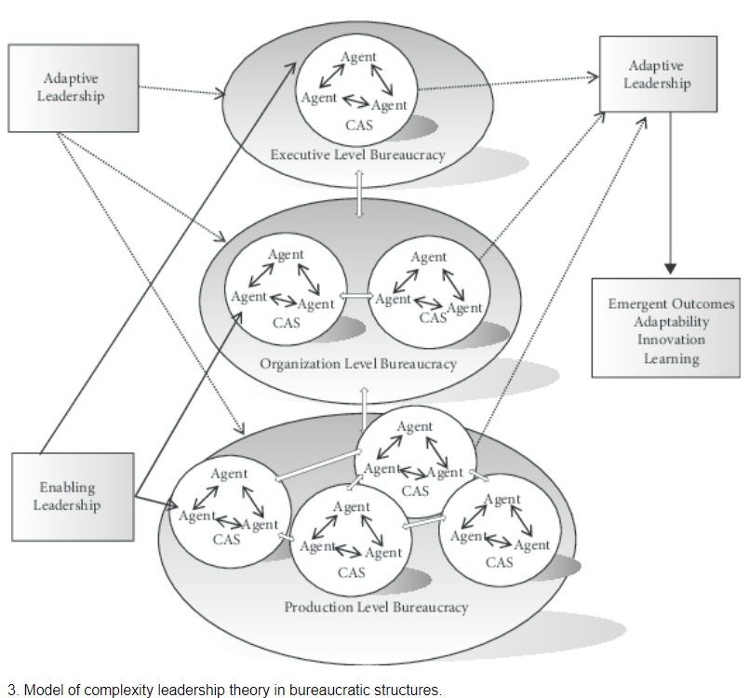
Notes:
Complexity and chaos theory
Complexity does not equate to complicated.
The complex of traits a leader exhibits to lead in either an adaptive or an enabling manner.
CAS or complex adaptive systems. These are the basic unit of analysis; the thing to be changed, moved, or augmented.
CAS are contextual
Enabling leadership, administrative leadership, and adaptive leadership
Adaptive is the primary driver of adaptive outcomes; focused on transformation (What items should we retain after covid? How will we do things differently?)
Enabling- catalyzes conditions allowing you to thrive. (Who do I need at the table to help make this decision? How can I empower them to do so?
Administrative- managerial roles that must be attended to for organizational sustainability. ((What will we do about registration? Housing? Etc?

Slide 20
Crisis Decision Theory (CDT)
1. Behavioral Psychology, founded in the Transactional Model of Stress and Coping (Lazarus & Folksman, 1984)
2. Two Primary questions:
a) What decisions processes occur when people respond to a crisis event? and b
b), What factors predict individuals’ response choices?
3. The three phases of CDT are:
a) assessment of severity of the crisis event,
b) arrival at conclusions about various crisis responses, and
c) evaluation and implementation of crisis response options (Sweeney, 2008).
Notes:
Crisis Decision Theory (CDT) as out conceptual framework. CDT is a behavioral decision theory that has its foundations in the Transactional Model of Stress and Coping (Lazarus & Folksman, 1984) and the Self-Regulation Model of Illness posited by (Leventhall, Nerenz, & Steele, 1984). CDT is concerned with two primary questions: 1) What decisions processes occur when people respond to a crisis event? and 2), What factors predict individuals’ response choices? CDT addresses these questions using three-stage model that describes what individuals go through in non-linear, cyclical fashion when facing a crisis event. The three phases of CDT are: a) assessment of severity of the crisis event, b) arrival at conclusions about various crisis responses, and c) evaluation and implementation of crisis response options (Sweeney, 2008).

Slide 21
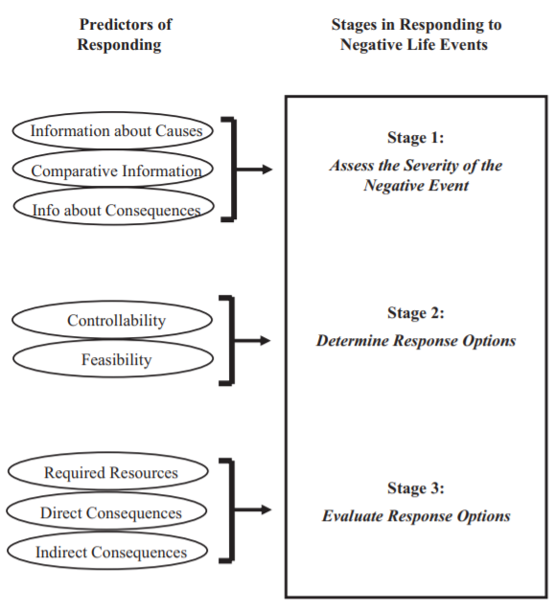
Sweeny, K. (2008) Crisis Decision Theory: Decisions in the face of negative events. Psychological Bulletin, 134(1), 61-74.
Notes:
Part of the leadership in this issue is not taking imprecise stabs at imperceptible issues.
The root cause changes with the problem…so its not a virus or the pandemic, writ large that might be the issue but a specific person’s reaction to the virus or lack of information. So slow down and assess the actual situation; not a phantom one.
Naming an issue exactly helps you and those around you begin to work on it rather than pause in fear over a major mountain you have to climb.
Are there other times when we’ve dealt with this…other colleagues?
What happened to them. How likely is a consequence? There is a lot of natural fear and not just about the virus, but about enrollment, funds, employment status, loss of life, will policies fit the needs, families, shifting locus of control
Response options…what can you realistically do? What’s unrealistic? What's wild and crazy and cuts against the grain?
What will the future be for us to judge feasibility. There are ways to judge that.
Evaluate options…Resources and priorities. We always think about what we have but do we think about what we could re-prioritize.
There is a reaction for every decision…not an equal and opposite, but lets face it there is some hysteria and some unreasonableness going on right now. As much as you can see what your direct consequences are and what unintended consequences might be.

Slide 22
Situational Crisis Communication Theory (CCT)
Only after truly knowing and planning for an issue can you communicate about it.
Match a crisis response/communication with the proper response and threat,
Notes:
Situational Crisis Communication Theory (SCCT, 2007), posited by W. Timothy Coombs is a theory in the field of crisis communication. It suggests that crisis managers should match strategic crisis responses to the level of crisis responsibility and reputational threat posed by a crisis.
Communicate half cocked and see what happens.

Slide 23
Know your crisis
Three Crisis “Clusters”
Victim Cluster- Organizations can also be a victim
Accidental Cluster- Organization’s actions leading to
the crisis were unintentional or beyond their control.
Intentional Cluster- The organization knowingly placed
people at risk.
Notes:
Situational Crisis Communication Theory (SCCT, 2007), posited by W. Timothy Coombs is a theory in the field of crisis communication. It suggests that crisis managers should match strategic crisis responses to the level of crisis responsibility and reputational threat posed by a crisis.
Communicate half cocked and see what happens.
An interesting situation arises when your constituents think you’re in a differen cluster than you are…the Kroger lady and “killing kids” comment. She thought I was in the intentional cluster and had completely concoted all these reasons, money, prestige, access for my kids over hers. This helps me frame my message around one that reorients her to the accidental nature of this issue (rather than just cussing her out)

Slide 24
Crisis Response Strategies

Slide 25
Some Trends

Slide 26
Estimates from the American Council on Education forecast that enrollments for the next academic year will drop by 15%, including a 25% decline in the number of international students.

Slide 27
10% of college-bound high school seniors have already made other plans.

Slide 28
In late-March, 14 percent of college students said they were unlikely to return to their current college or university in the fall.

Slide 29
By mid-April that number had climbed to 26%.
There are numbers from last week suggesting intent to enroll is increasing now that colleges have announced plans, but..

Slide 30
Enrollment for all levels of college is expected to be down this coming fall, but for community colleges, there is an opportunity to obtain stable or nearly stable enrollment trends.

Slide 31
Eighty-five percent of colleges students want to go back to campus.
The (low) quality of online instruction in the spring was the primary reason

Slide 32
The numbers are particularly bleak for minority students.
Forty-one percent of minority high school seniors say it's likely they won't go to college at all in the fall.
Notes:
Ten percent of college-bound seniors who had planned to enroll at a four-year college before the COVID-19 outbreak have already made alternative plans.
Fourteen percent of college students said they were unlikely to return to their current college or university in the fall, or it was "too soon to tell." Exactly three weeks later, in mid-April, that figure had gone up to 26 percent.
Gap years may be gaining in popularity. While hard to track, there are estimates that 3 percent of freshmen take a gap year. Since the pandemic, internet searches for gap years have skyrocketed.
College students do not like the online education they have been receiving. To finish their degrees, 85 percent want to go back to campus, but 15 percent want to finish online.
The numbers are particularly bleak for minority students.
Forty-one percent of minority high school seniors say it's likely they won't go to college at all in the fall or "it's too soon to say." That compares to 24 percent of white high school seniors. With deadlines looming (some colleges expect answers to admissions offer by May 1, although many have delayed the date), 24 percent of minority students say they haven't decided which college to attend. The number for white students is 14 percent. Because of COVID-19, the top choice of college has changed for a third of undecided minority students but only 15 percent of undecided white students.

Slide 33
24 percent of white high school students are undecided about college.
Because of COVID-19, the top choice of college has changed for a third of undecided minority students but only 15 percent of undecided white students.
https://www.insidehighered.com/admissions/article/2020/04/29/colleges-could-lose-20-percent-students-analysis-says
Notes:
Ten percent of college-bound seniors who had planned to enroll at a four-year college before the COVID-19 outbreak have already made alternative plans.
Fourteen percent of college students said they were unlikely to return to their current college or university in the fall, or it was "too soon to tell." Exactly three weeks later, in mid-April, that figure had gone up to 26 percent.
Gap years may be gaining in popularity. While hard to track, there are estimates that 3 percent of freshmen take a gap year. Since the pandemic, internet searches for gap years have skyrocketed.
College students do not like the online education they have been receiving. To finish their degrees, 85 percent want to go back to campus, but 15 percent want to finish online.
The numbers are particularly bleak for minority students.
Forty-one percent of minority high school seniors say it's likely they won't go to college at all in the fall or "it's too soon to say." That compares to 24 percent of white high school seniors. With deadlines looming (some colleges expect answers to admissions offer by May 1, although many have delayed the date), 24 percent of minority students say they haven't decided which college to attend. The number for white students is 14 percent. Because of COVID-19, the top choice of college has changed for a third of undecided minority students but only 15 percent of undecided white students.

Slide 34
24 percent of white high school students are undecided about college.
Because of COVID-19, the top choice of college has changed for a third of undecided minority students but only 15 percent of undecided white students.
https://www.insidehighered.com/admissions/article/2020/04/29/colleges-could-lose-20-percent-students-analysis-says
Notes:
Ten percent of college-bound seniors who had planned to enroll at a four-year college before the COVID-19 outbreak have already made alternative plans.
Fourteen percent of college students said they were unlikely to return to their current college or university in the fall, or it was "too soon to tell." Exactly three weeks later, in mid-April, that figure had gone up to 26 percent.
Gap years may be gaining in popularity. While hard to track, there are estimates that 3 percent of freshmen take a gap year. Since the pandemic, internet searches for gap years have skyrocketed.
College students do not like the online education they have been receiving. To finish their degrees, 85 percent want to go back to campus, but 15 percent want to finish online.
The numbers are particularly bleak for minority students.
Forty-one percent of minority high school seniors say it's likely they won't go to college at all in the fall or "it's too soon to say." That compares to 24 percent of white high school seniors. With deadlines looming (some colleges expect answers to admissions offer by May 1, although many have delayed the date), 24 percent of minority students say they haven't decided which college to attend. The number for white students is 14 percent. Because of COVID-19, the top choice of college has changed for a third of undecided minority students but only 15 percent of undecided white students.

Slide 35
Implications in Student Affairs, Athletics, Finance, etc.
With revenues of all kinds expected to decline, expenses for new processes are going to strap expenses even further. Reprioritization is going to be key (Smalley, 2008).
Notes:
Ten percent of college-bound seniors who had planned to enroll at a four-year college before the COVID-19 outbreak have already made alternative plans.
Fourteen percent of college students said they were unlikely to return to their current college or university in the fall, or it was "too soon to tell." Exactly three weeks later, in mid-April, that figure had gone up to 26 percent.
Gap years may be gaining in popularity. While hard to track, there are estimates that 3 percent of freshmen take a gap year. Since the pandemic, internet searches for gap years have skyrocketed.
College students do not like the online education they have been receiving. To finish their degrees, 85 percent want to go back to campus, but 15 percent want to finish online.
The numbers are particularly bleak for minority students.
Forty-one percent of minority high school seniors say it's likely they won't go to college at all in the fall or "it's too soon to say." That compares to 24 percent of white high school seniors. With deadlines looming (some colleges expect answers to admissions offer by May 1, although many have delayed the date), 24 percent of minority students say they haven't decided which college to attend. The number for white students is 14 percent. Because of COVID-19, the top choice of college has changed for a third of undecided minority students but only 15 percent of undecided white students.

Slide 36
You are not alone.

Slide 37
Research on COVID-19’s influence on higher education
https://shsu.ideascale.com
You must register, so please check your junk mail folder. Participation is quick and easy. Please share this link widely. Join in the conversation. Share ideas and share the platform with your colleagues.

Slide 38


Slide 39
Check in on each other and your families and communities.
Notes:
Sinem

Slide 40
Resources
Center for Assessment, Research, and Educational Safety
https://www.shsu.edu/centers/cares/
Facebook: https://www.facebook.com/SHSUEduSafety
Twitter: @SHSUEduSafety
Fuller, M. and Walkley, C. (2020). Ten Tips to Help Educators Prepare for the Fall 2020 Return to School. Sam Houston State university: Huntsville, TX.
Resources for Online Learners
Matt Fuller, Ph.D.
EdSafety@shsu.edu
936.294.1865
Notes:
SInem

Slide 41

Notes:
Matt

