Slide 1
Reframing and Re-envisioning
Enrollment and Student Success
Patricia Alvarez McHatton, EVPAA

Slide 2
Overview
My Story – Your Story
Current Realities
Student Profiles
Student Success
Things to Consider

Slide 3
Our

Slide 4
Higher education is important
Ticket to Middle Class
Income Differential
Dividing Line
How people vote
Likelihood of owning a home
Geographic Mobility (Kirp, 2019)
Lack of a College Degree is a Public Health Crisis (Andres, 2018)

Slide 5
Current Realities
Loss of Confidence in Higher Education
Shifting Demographics
Growing Financial Need
Ambiguous Future
Emphasis on Degrees Leading to Jobs
Student Graduation Rates
Student Characteristics
Fill in the blank ____________

Slide 6
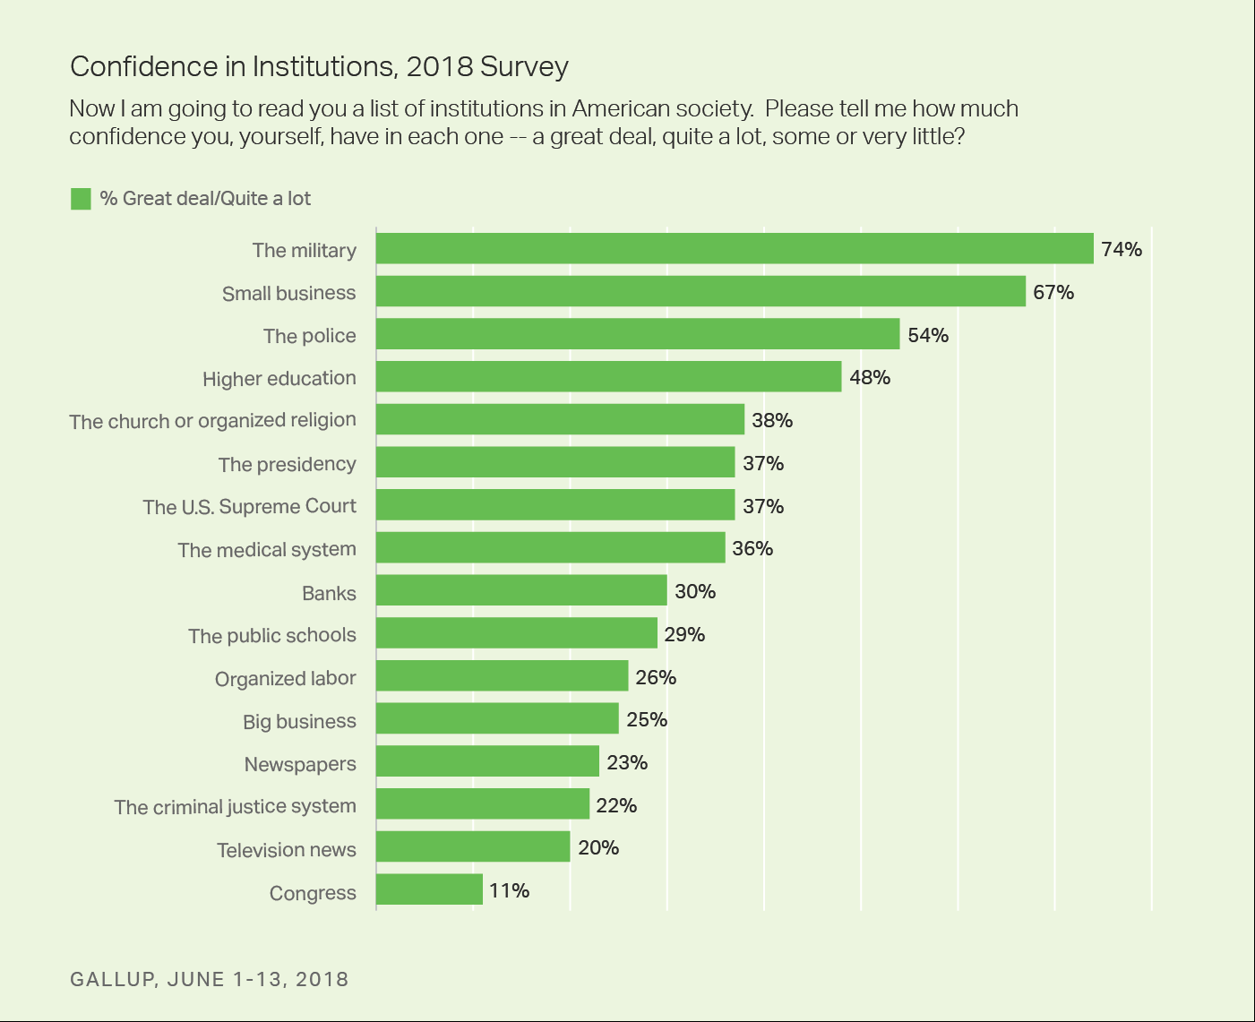
Gallup 2018 Survey: Confidence in Institutions

Slide 7
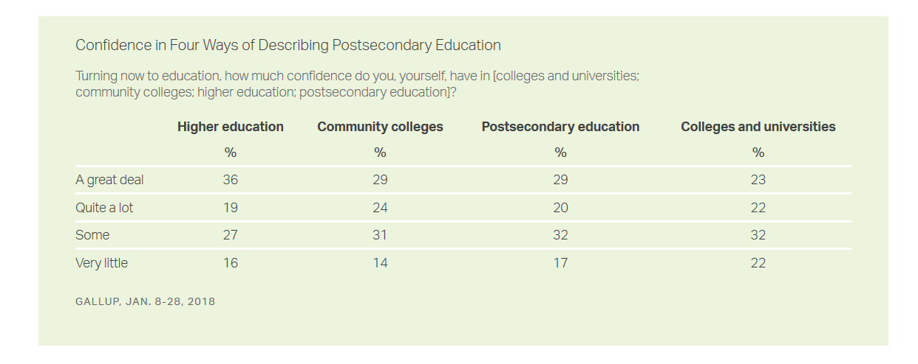
Language Matters

Slide 8
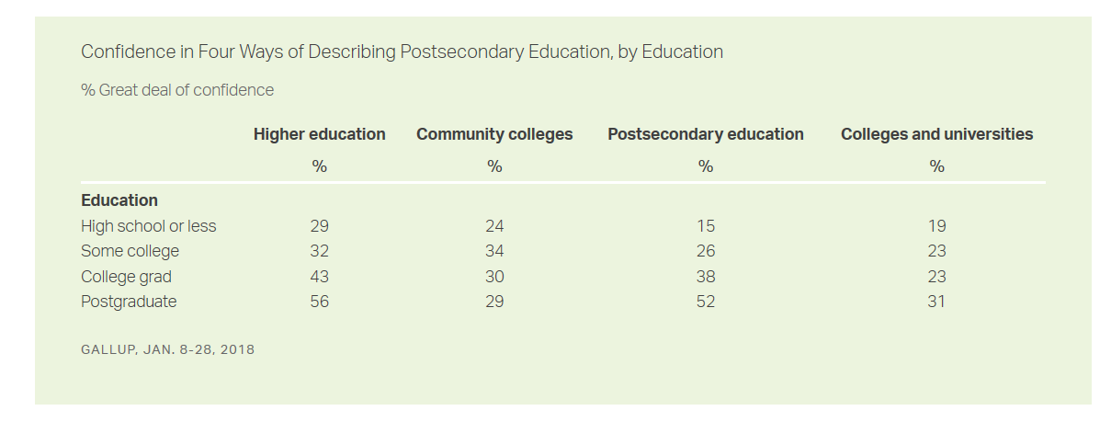
Education level matters

Slide 9
shifting demographics
Migration Patterns
Southwesterly distribution
Nation-wide Reduction in Fertility
Increase in diversity
Increase in Educational Attainment
Projection:
10% reduction in college enrollment by end of 2020s
Grawe, 2019

Slide 10
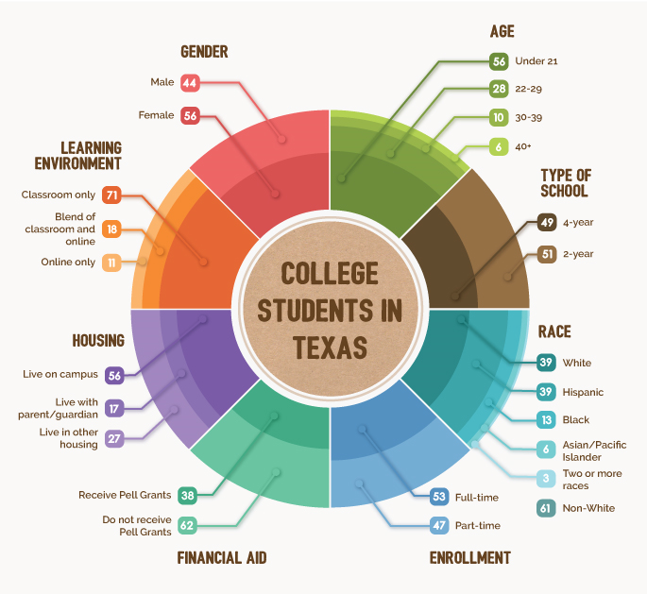
Bill & Melinda Gates Foundation, 2019

Slide 11
Growing Financial Need
Number of states where students from low-income backgrounds ($20,000-$40,000) exceed 50% of the total student population
2000
4
2013
20
Selingo, 2017

Slide 12
Archer’s dilemma (Ruben, 2018)
Ambiguous Future

Slide 13
Impact of Technology and ai on future jobs
New technology beginning to “displace cognitive capability or even intellectual capability”
“You want to stay away from [repetitive] things and instead, you want to do things that are more creative, things that maybe involve lots of sophisticated interaction and relationship building with other people because these are things that machines right now are not good at.”
Martin Ford
Rise of the Robots: Technology and the Threat of a Jobless Future
Burkhardt, 2019

Slide 14
Impact of Technology and ai on future jobs
Others have a more positive outlook:
New applications of AI combined with human collaboration could boost employment worldwide as much as 10 percent by 2020 (Reese, 2019).
Regardless:
“… the most important skill anyone can learn for this future that we’re facing is how to keep learning, how to adapt and how to throughout your life continue to learn and to do that very effectively and how to really enjoy that; to love learning” (Ford, 2019)

Slide 15
Postsecondary graduation rates
Completion Rate Improving Slightly
Gains for Black and Hispanic Students
Completion gap remains
Increases in Completion Rates for Students who Started at 2-Year Public Institutions

Slide 16
Postsecondary graduation rates
Per National Center for Education Statistics (2019)
4-year: 41%
5-year: 56%
6-year: 60%

Slide 17
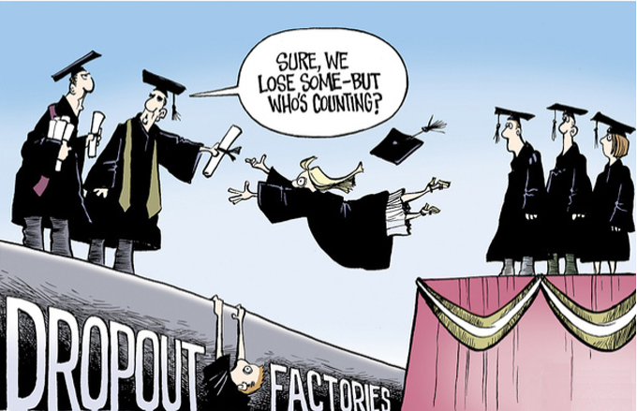
~40% of Students Don’t Graduate

Slide 18
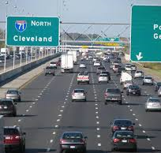
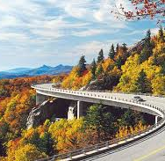
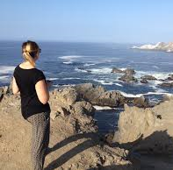
Student characteristics
Notes:
Sprinters, wanderers, stragglers
79% sprinters had at least one internship
47% wanderers
24% stragglers

Slide 19
student Characteristics

Slide 20
How would you describe your students?

Slide 21
The rest of the story
100% of our Students
100% of our Families
Are committed to family;
Persevere in their educational endeavors;
Understand responsibility; and
Want to give back to their community.
Understand the value of an education;
Support their child’s pursuit of an education; and
Want to be included in their child’s progression in higher education.

Slide 22
Student success
OUR FOCUS

Slide 23
Student success
What are we saying when we admit a student?
What is our responsibility to that student?

Slide 24
Know your students

Slide 25
Asset Based approach
Asset Based
Deficit Based
Strengths Driven
Focused on Opportunity
Internally focused
Builds upon what Exists
Needs Driven
Focused on Problems
Externally Focused
Looks for what is Missing

Slide 26
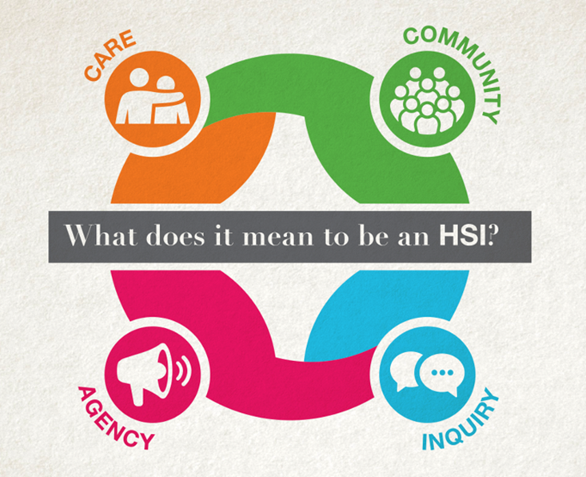
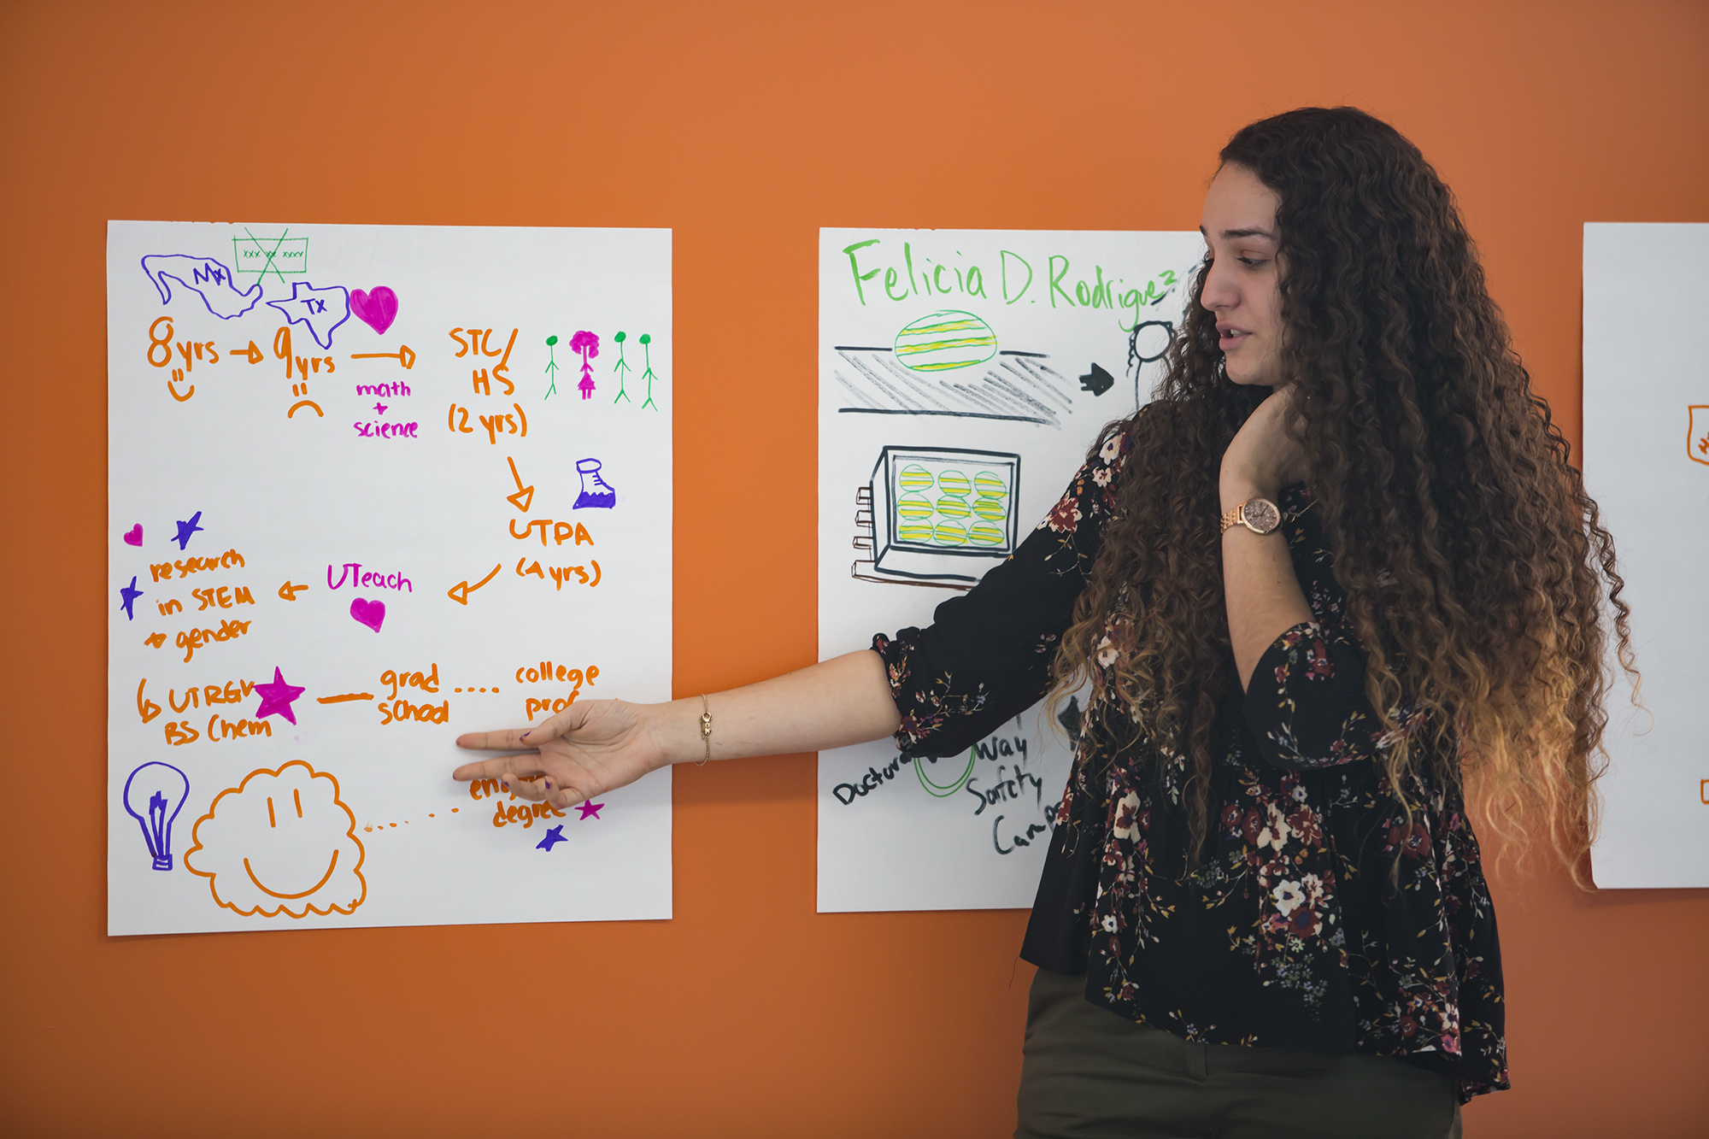

Slide 27
Student success
Need to Attend to the:
Personal
Social
Academic
Life Issues
Institutional Issues

Slide 28
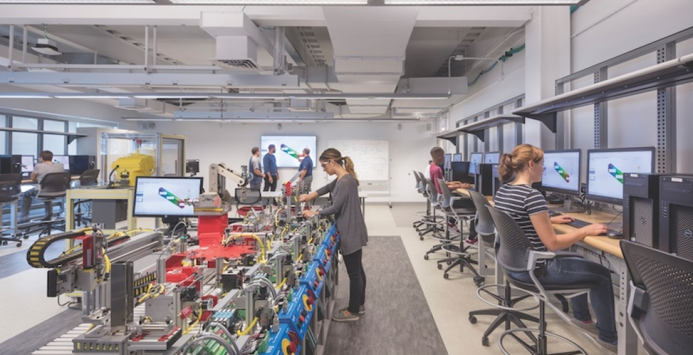
Attend to the quality of instruction
World Class Research Institutions need World Class Teachers

Slide 29
Teachers
Matter
Talk about the power of teachers in K-12 but not so much in higher education
High-quality teaching is a key factor in persistence and Graduation (Saroyan & Trigwell, 2015)
Effective teaching improves students’ critical thinking (Condon, Iverson, Manduca, Rutz, & Willett, 2016)

Slide 30
Teachers
Impact student aspirations
Fuel students’ passion, interest, and motivation for learning
Improve students’ sense of academic ability and value

Slide 31
How instruction happens matters
Transparency
Pedagogical Approaches
Assessment
Reflection and Self-Regulation
Alignment
Relevance

Slide 32
Inclusive Teaching
Values course design
Not just the way teach, but how we prepare our materials
Values discernment
Critical self-reflection
Values a sense of belonging
Ensure a positive, shared learning environment
Gannon, 2018

Slide 33
Students as learners and teachers (salt)
Paid pedagogical consultants to faculty
Pose questions to faculty to help them identify their assumptions about learning and students
Attend class as an observer
Semester long project
Meet weekly with faculty to suggest revisions and ways to make the classroom more inclusive
Cook-Sather, 2019
Bryn Mawr College

Slide 34
National Survey on Student Engagement
Theme | Engagement Indicators
Academic Challenge | Higher-Order Learning Reflective & Integrative Learning Learning Strategies Quantitative Reasoning
Learning with Peers | Collaborative Learning Discussions with Diverse Others
Experiences with Faculty | Student-Faculty Interaction Effective Teaching Practices
Campus Environment | Quality of Interactions Supportive Environment

Slide 35
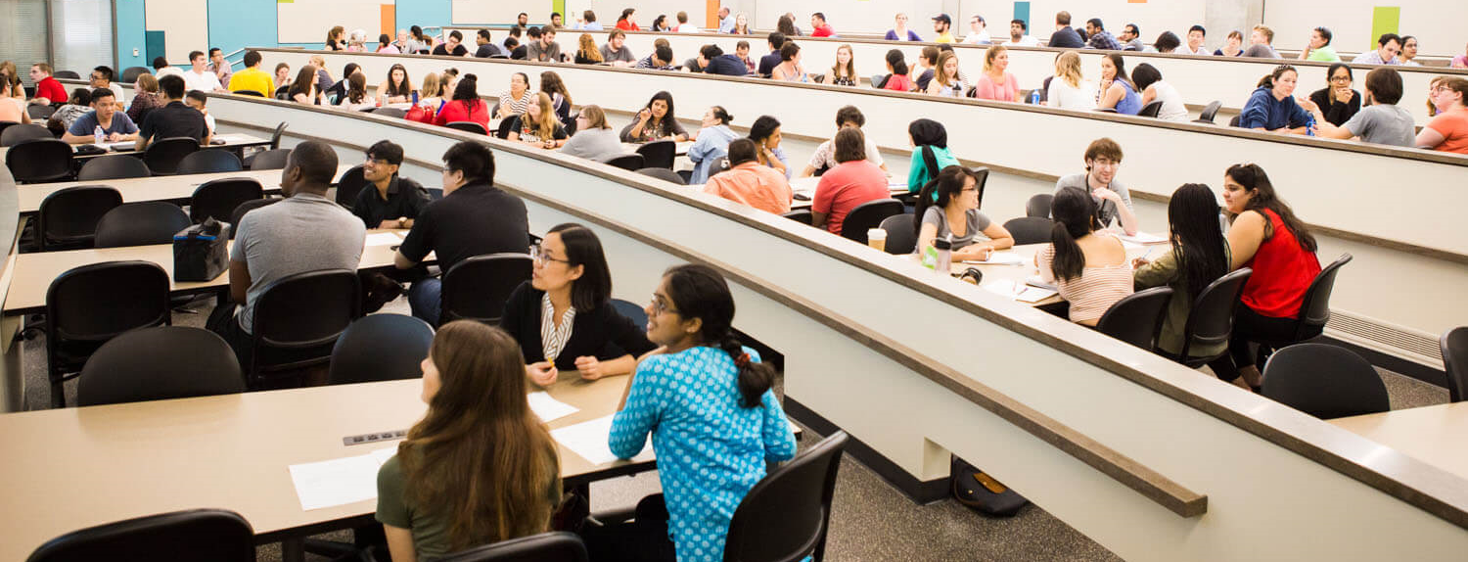
How do we value teaching?

Slide 36
Student success
What made the difference in your educational journey?

Slide 37
Focus not on what you can expect Focus on what they can become
Freeman A. Hrabowski III
President of the University of Maryland-Baltimore County

